Slide 1
Candidate Information Workshop
Santa Cruz County Clerk & Watsonville City Clerk
Monday, June 22, 2020

Slide 2

Ballots will be mailed to ALL voters in November!
We will mail ballots to all voters in Santa Cruz County to promote safe voting at home.
We will have 14 drop boxes available 24/7 until 8pm Election Night, plus drop boxes at each voting location, city clerks’ office & postage paid envelopes for easy return.
We plan to have 17 in-person voting locations open Saturday – Tuesday, Oct. 31 to Nov. 3 to flatten the voting curve, per the Governor’s Executive Order to have 1/10k voters.

Slide 3
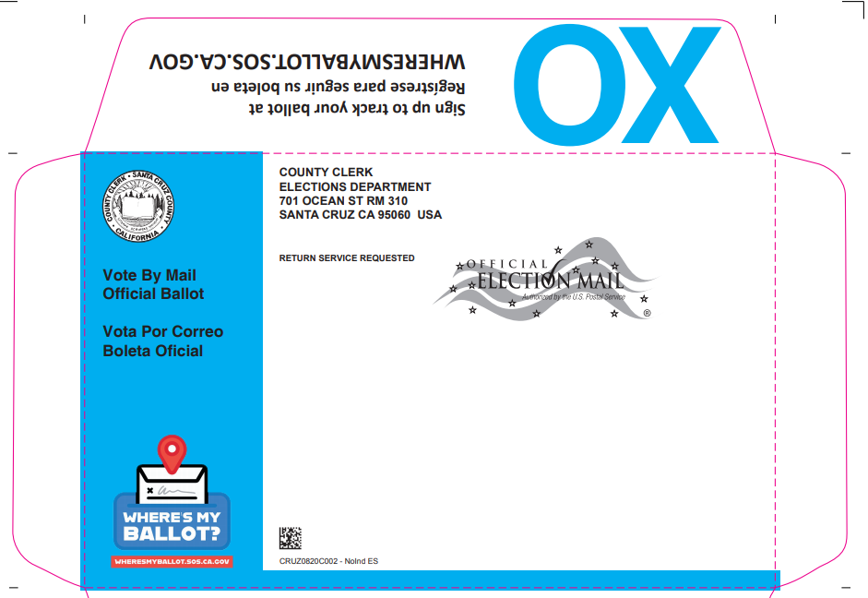
Our ballots will be mailed with a hug & a kiss!
BallotTrax to track your ballot!

Slide 4
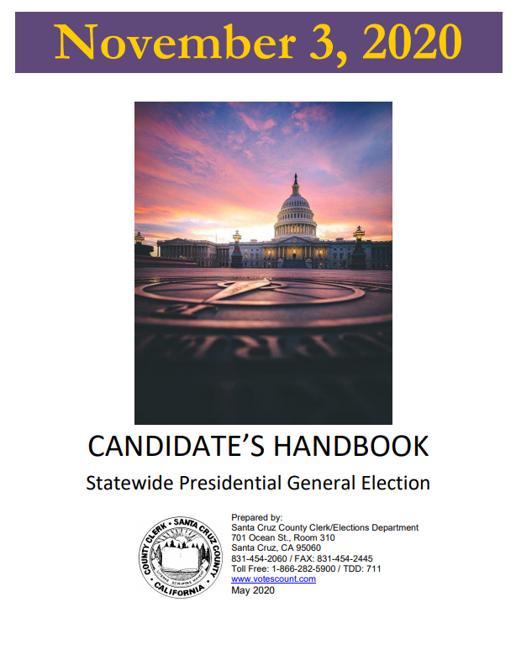
Candidate’s Handbook is posted online at www.votescount.us
Hard copies available at Clerk/Elections.
City Clerks will have their own guides.

Slide 5
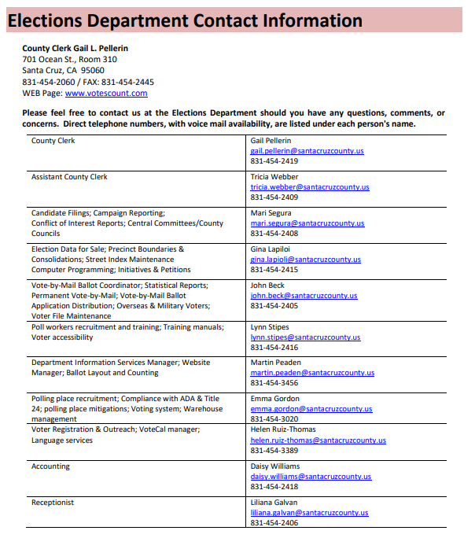
How to contact us.
Ask questions.
Get help!

Slide 6
State and Federal Offices
Fair Political Practices Commission: Campaign reporting (Forms 501, 410, 460, 470, 497…); Conflict of Interest Form 700; investigates campaign violations
Secretary of State: File Form 410; conducts random alpha to determine order of candidate’s names; investigates voter fraud
Attorney General: legal opinions; incompatibility of offices
Franchise Tax Board: Audits campaign reports
Federal Election Commission: Campaign reporting for federal offices

Slide 7
Who to call for election violations?
False or misleading campaign materials (No agency enforcement. These issues are dealt with in court).
Violations of the Political Reform Act: contact the Fair Political Practices Commission at www.fppc.ca.gov, 866-275-3772.
Election fraud: contact your local district attorney, 454-2400, or the California Secretary of State at www.sos.ca.gov, 916-657-2166.
Vandalism or requirements concerning campaign signs: contact local city attorney or district attorney, or local law enforcement.
In other words… not my office!

Slide 8
Key Dates and Deadlines
July 13 – August 7: Candidate filing
August 7 – 12: Candidate filing extension if the incumbent does not file
August 13: Random Alpha – SOS alpha will determine order of local contests. County random will determine order of State Senate and State Assembly
September 4: Military and Overseas ballots go out - RAVBM
October 5: First day to mail ballots. Current VR = 166,218
October 19: Last day to register to vote – may be extended
October 31 – November 3: Voter service centers open
  9am to 5pm on Saturday and Sunday
  8am to 5pm on Monday
  7am to 8pm on Tuesday
November 29: Deadline to cure a missing or non-comparing signature
November 30: Deadline to declare those elected to school and special districts. Conflicts with the other deadlines to certify the election.
December 1: Deadline to certify presidential contest. Dec. 3 for all others.

Slide 9
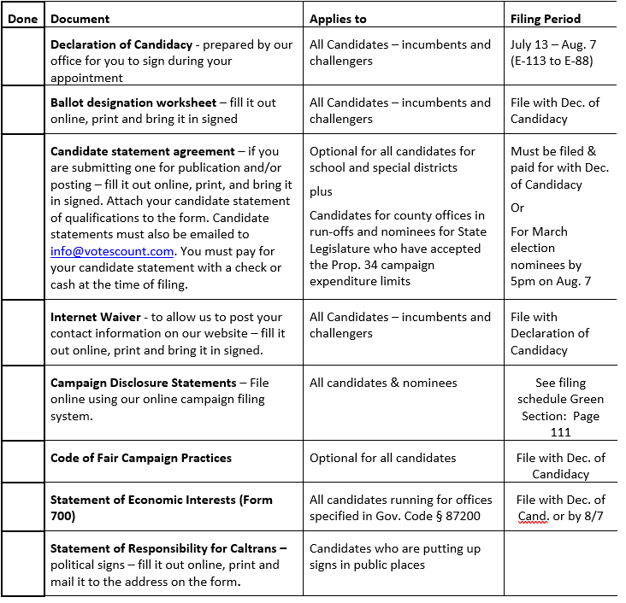
Candidate Checklist
Use our website!
www.votescount.us

Slide 10

Safe Candidate Filing for school & special districts
First, candidates will complete the preliminary candidate information and submit to us to prepare their Declaration of Candidacy.
Candidates will use our ONLINE appointment calendar to set up time to come in and file paperwork.
All docs are posted online. Candidates are encouraged to complete and print the forms and bring with them to their scheduled appointment.

Slide 11
Filing for Watsonville City Council
Schedule
Call or email the Watsonville City Clerk Beatriz Flores to make an appointment to pick up or drop off nomination papers:
831-768-3040
cityclerk@cityofwatsonville.org
Issue
The City Clerk will issue you your Nomination Petition.
Collect
Collect 20 valid signatures from voters within the city.

Slide 12
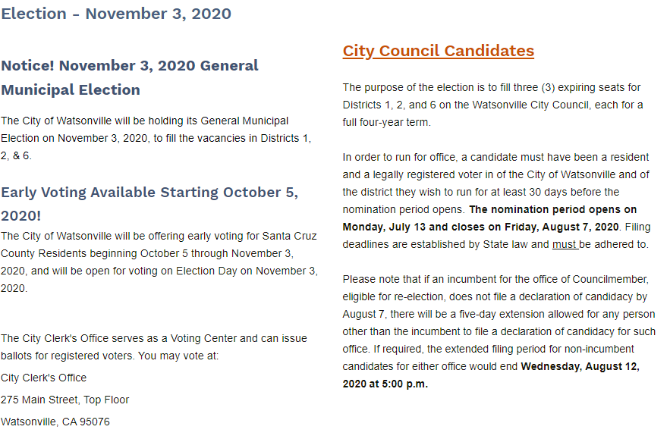
Watsonville City Clerk’s Website https://cityofwatsonville.org/1687/November-3-2020-Election

Slide 13
Collecting signatures in a COVID world – advice from
Dr. Gail Newel
It is hard to get COVID-19 from inanimate objects.
The biggest risk lies with close contact with other people. Close contact is defined as within six feet for more than 10 minutes, regardless of face coverings.
As case rates continue to increase, it is more important than ever to follow the social distancing requirements, which include:
Wearing a face covering while engaging with others at work or in public;
Keeping a six-foot distance from persons who are not members of your household;
Frequently washing hands with soap and water for at least 20 seconds;
Covering coughs or sneezes with tissue or fabric, or using your elbow; and
Staying home if you are sick with a fever or cough.
Candidates are encouraged to collect signatures in an outdoor public setting where they can stand more than six feet away from the papers and the people signing them.

Slide 14
If you are running for City Council, you need to file documents with the City Clerk
Candidate filing is July 13 – August 7. If an incumbent who is not termed out does not file for re-election, filing is extended to Wednesday, August 12 for anyone other than the incumbent to file.
Nomination Petition with 20 valid signatures of voters who are registered in the City of Watsonville and the District the candidate is seeking election to.
Declaration of Candidacy – may be part of the Nomination Petition.
Ballot Designation Worksheet
Candidate Statement Agreement required only if you are filing a Candidate’s Statement of Qualifications
Internet Waiver to allow your name and contact information to be posted online
Code of Fair Campaign Practices – optional
Form 700 – Statement of Economic Interest

Slide 15

Offices on the ballot
Nominees for:
President & Vice President
Congress
State Senate
State Assembly
Superior Court Judge
County Supervisor, 1st District
And
City Councils: Capitola (2); Santa Cruz (4), Scotts Valley (3),
Watsonville (Districts 1, 2 & 6)
2 County Boards of Education/2 Community College Boards
6 Unified School Districts
8 Elementary School Districts
9 or 10 Fire Districts (Central and Aptos may merge)
5 Water Districts
Port District
2 Recreation Districts

Slide 16
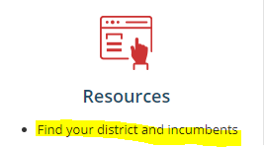
Where you live determines what you can run for
For most offices, you must be a registered voter of the jurisdiction and in some cases, you must live in the subdivision of the jurisdiction (trustee area/division/district) in order to run for office.
You can look up the jurisdictions you live in
online at www.votescount.us
There are laws and court cases governing
residence and domicile.

Slide 17
Incompatibility of office
The State of California Attorney General’s Office has issued many opinions about incompatibility of offices. Here are eight examples of incompatible offices:
  1. The offices of city councilman and school district board member where the city and the school district have territory in common;
  2. fire chief of a county fire protection district and member of the board of supervisors of the same county;
  3. high school district trustee and trustee of an elementary school district which is wholly within the geographic boundaries of the high school district;
  4. water district director and a city council member;
  5. county board of supervisors member and community college board member;
  6. water district director and a school district trustee having territory in common;
  7. deputy sheriff and county supervisor; and
  8. county planning commissioner and county water district director.
If you have a question about whether two public offices which you hold or seek to hold would be considered incompatible, contact the Attorney General’s office at 800-952-5225 or visit their website, www.oag.ca.gov.

Slide 18
Name and Ballot Designation
Follow SOS Ballot Designation Regulations!
A candidate registered as Margaret Ann Smith may use such variations as Margaret A. Smith, Maggie Smith, Meg Smith, or Annie Smith. Nicknames may be designated by parentheses or quotation marks.
The ballot designation is the word or group of words that will appear on the ballot under the candidate's name, designating the principal profession, vocation, or occupation of the candidate.
You can also use the word “None.”
You are allowed a total of 39 characters for your name and 39 characters for your ballot designation so it will fit nicely on the ballot.
All candidates must completely fill out the ballot designation worksheet. You are encouraged to provide two alternatives to your first choice.
If your first choice is rejected, we will inform you which one is allowed. If all three are rejected, you will be notified in writing and given 3 days to provide an acceptable ballot designation.

Slide 19
Candidate Statement of Qualifications – Optional
If you choose to submit a Candidate’s Statement of Qualifications, you must file and pay for it at the time you file your Declaration of Candidacy.
The cost is an estimate and you will receive a refund or invoice a month or more after the election if you overpaid or underpaid.
Statements are limited to 200 words for most offices. 250 words for Congress and State Legislative offices.
Statements must be in English.
One statement with English and Spanish or other language will not be accepted.
You can pay to have it
  printed & online in English,
  printed & online in English and Spanish,
  online only in English or
  online only in English & Spanish.

Slide 20
Content and Format of your Statement of Qualifications
Type your statement. Proof it. Statements will be printed as filed.
Limit your statement to a recitation of your own personal background and qualifications.
Do not reference other candidates for that office or another candidate’s qualifications, character, or activities.
Candidates for nonpartisan offices shall not include your party affiliation nor membership or activity in partisan political organizations.
No statement shall contain any false, slanderous or libelous statements.
You are encouraged to limit your statement to 3 paragraphs.
All text will be formatted flush left – no indents will be allowed.
On the line below your name, you may provide your occupation, phone number, email, website address, and/or age, if it fits on one line.
Your name should be the same as your name on the ballot. Occupation should be the same or similar to your ballot designation.
Statements are printed in the county Voter Information Guide in 9-point ClearViewADA font.
Bolding, CAPITALIZING, underlining, bullets and centering text are not permitted. If the statement contains any bolding, capitalizing (other than abbreviations or acronyms), underlining, and centering of text, the text will be converted to normal text without these attributes.
Limited use of italics is permitted.

Slide 21
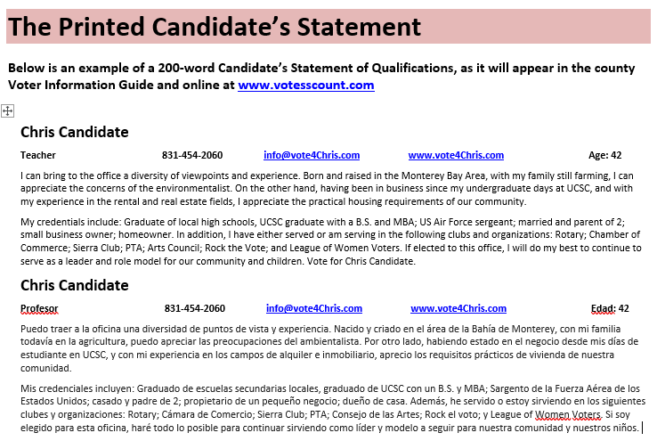

Slide 22
Filing your Statement of Qualifications
Candidate Statements must be submitted in an electronic format or pay $100 extra!!
E-mail your statement to gail.pellerin@santacruzcounty.us or bring in on a thumb drive.
File ONE signed hard copy by the deadline.
Payment: The statement may be paid for by check made payable to the County Clerk or cash if the candidate is using personal funds and will not be reimbursed through their campaign committee. The fee shall be paid at the time candidates file their Declarations of Candidacy.
Statements may not be changed but may be withdrawn no later than 5pm on Monday, August 10. If there is an extended filing time, no later than 5pm on Thursday, August 13.

Slide 23
Important notices about Statements of Qualifications
Important notice to candidates in districts that encompass more than one county. Procedures, requirements, fees, formats and public examination periods for candidates’ statements may vary between counties. It is the candidate’s responsibility to contact each county (in which he or she wishes to have a statement printed) within the district to obtain the appropriate information from each county. Failure to do so may jeopardize the printing of the candidate’s statement. Candidates’ statements shall be filed in each county by the candidate.
It is strongly recommended that you file the statement personally. If the statement is filed by someone other than the candidate, that person should have the authority to make corrections or deletions to the statement in case there are errors or there are too many words. Statements received by mail prior to the deadline will be filed if they meet the statutory requirements and county policies regarding candidates’ statements. Statements may not be changed after filing.

Slide 24

Cost of Statement of Qualifications
Cost Formula: The cost of the Candidate’s Statement is based on a quarter page for 200-word statements or half page for 250-word statements.
The estimated cost of printing the statement in the county Voter Information Guide and posted online is $320, plus $.03 per voter in the district for printing and mailing the voter guide.
Candidates who do not submit their statement in a readable electronic format will pay $100 extra.
The optional Spanish statement will be $150 extra for print & online or online only.
Candidates can opt to have their statement posted online only for $320 in English, and $470 in English & Spanish.

Slide 25
Watsonville City Council Candidate Statements of Qualifications
Candidates who want a statement to be printed in the County Voter Information Guide mailed to all registered voters must file their statement with the Watsonville City Clerk and pay the estimated cost of $382 to 415. Add an additional $150 for Spanish = $532 to $565.
Candidates can also opt for online only on the county’s website for $320, $470 for English and Spanish.

Slide 26
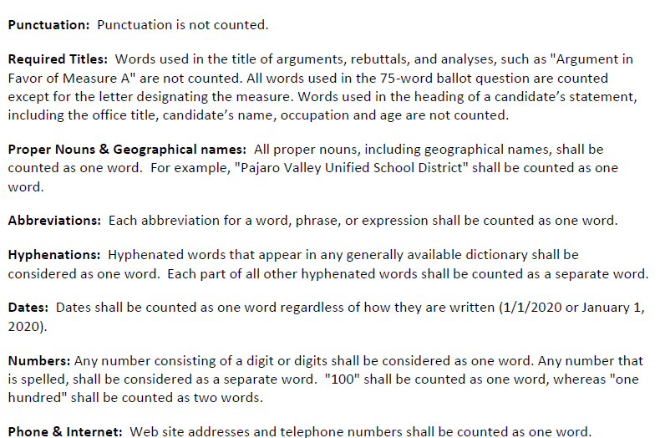
How to count words

Slide 27
Registration and Election Data
Confidential Voter File
Pursuant to Elections Code Sections 2187, 2188 and 2194, voter registration information is available to persons or groups for election, scholarly, journalistic or political purposes, or governmental purposes, as determined by the Secretary of State. Each written request to view, purchase, or use voter registration information must be submitted in person and with identification on an application available at the Santa Cruz County Elections Department.
Form to purchase voter file data is online at www.votescount.us
We also post who is purchasing data.

Slide 28
Voter Registration
Deadline is October 19 – may be changed due to COVID.
Voters can register to vote online at www.registertovote.ca.gov.
Cards are available at post offices, city halls, DMV, or we can mail them to a voter.
Voter outreach limited due to COVID.
If a voter does not sign up in time, California now has Same Day Voter Registration where voters can register and vote up to and including Election Day.
Provisional voting will continue to be used in the event a voter’s eligibility cannot be determined at the time they show up to vote.

Slide 29
Voting in November 2020
Pursuant to Governor Newsom’s Executive Orders N-64-20 signed on May 8 and N-67-20 signed June 3, elections officials will mail ballots to all voters in the State of California. Mailing ballots to all voters is intended to preserve public health in the face of the threat of COVID-19, and to ensure that the November election is accessible, secure and safe for all Californians who can vote from the safety of their own homes. In-person voting options will also be provided.
October 5, 2020 is the first day Santa Cruz County will mail ballots to voters who are registered to vote and on the active voter file.
Ballots are also available at the Santa Cruz County Elections Department and the Watsonville City Clerk’s Office from October 5 through 8pm Election Day, November 3.

Slide 30
How to return your ballot after voting from home
Voters may return their ballot in one of the following ways:
Drop it off at one of our 24-hour drop boxes
  Aptos - Cabrillo College Parking lot R by the stadium
  Aptos – Public Library, 7695 Soquel Dr.
  Aptos - Polo Grounds near the dog park, 2255 Huntington Dr.
  Ben Lomond - Highlands Park, 8500 Highway 9
  Capitola – 420 Capitola Ave in the City Hall parking lot
  Felton - Covered Bridge Park at Mt. Hermon and Graham Hill Rd
  Santa Cruz - 701 Ocean St in front of the County Government Center
  Santa Cruz – 212 Church St in the public parking lot
  Scotts Valley – 1 Civic Center Dr in the City Hall parking lot
  Watsonville – 316 Rodriguez St in the municipal public parking lot 14
  Watsonville – 1432 Freedom Blvd parking lot
  UCSC Quarry Plaza
  We will add two more drive-up drop off boxes for November.
Return it in person before and including Election Day at the County Elections Office or any of the City Clerks’ Offices.
Return it to a voter service center open Saturday, Oct. 31 to Tuesday, Nov. 3.
Mail it so it is received on time – ballots postmarked on or before Election Day and received by November 20, 17 days after the election, will be considered received on time.

Slide 31

In-person voting options.
In-person voting options will be available for voters to do any of the following:
  Return a voted ballot
  Obtain a second ballot
  Vote on the accessible tablet
  Vote a Spanish ballot on the tablet
  Register and vote on the same day
  Vote provisionally
  Any other voting service
In-person voting locations will include the Santa Cruz County Clerk’s Office and Watsonville City Clerk’s Office. Open 29 days.
The plan is to have 17 voter service centers to serve voters in the county from Saturday, October 31, through 8pm, Tuesday, November 3.
All centers will adhere to public safety guidelines regarding mask wearing, disinfecting, physical distances, and any other protocols that may be in place. Since this is an evolving situation and there is no way to know what will be happening in October, voters are directed to check the Santa Cruz County Elections Department’s website at www.votescount.us for the latest voting information.

Slide 32

Voter Service Center locations used in March
Santa Cruz County Clerk/Elections Office
Watsonville City Clerk’s Office
Simpkins Family Swim Center
Capitola City Hall
Community Foundation
Pajaro Valley Community Conference Room
UCSC – Bay Tree Conference Center
Scotts Valley Skypark
Zayante Fire Station
Ag Extension/Behavioral Health

Slide 33
Possible locations to add in November.
We need 7 more locations to meet ratio of 1/10k voters
Resurrection Church
Felton Library
Loma Prieta
Twin Lakes church
Highlands Park
Other ideas?

Slide 34
Campaigns need to help flatten the voting curve!

Slide 35
Vote-by-mail safeguards
Postmark + 17 (new law just signed)
Vote-by-mail ballots that are postmarked on or before Election Day or is time stamped or date stamped by a bona fide private mail delivery company on or before Election Day and received by the county elections official by the 17th day after the election shall be considered received on time.
The signature on the ballot envelope is compared to the signature on file.
Cure for unsigned ballot envelopes or non-comparing signatures
Voters who failed to sign their vote-by-mail ballot envelope or has a signature that does not compare to what is on file will have until 2 days prior to the certification of the election to provide a signature on a Signature Statement to the County Elections Department. The Signature Statement may be returned to the County Elections Official by mail, FAX, email, hand-delivered, or dropped off at a voter service center or drop box.
No one can solicit the vote of a vote-by-mail voter, or do any electioneering, while in the residence or in the immediate presence of the voter, and during the time he or she knows the vote-by-mail voter is voting.
Any person who knowingly violates this section is guilty of a misdemeanor.

Slide 36
Know the laws!
What you can and can’t do
Use of public resources
Mass Mailings
Slate Mailers
Filing Nomination Documents
Campaign literature
Misrepresenting yourself
Deceptive online activities
Political advertising
Simulated ballots
Pictures in campaign mail
Corrupting the voting process
Vandalizing a voting location
Corrupting voters or intimidating voters
Political signs

Slide 37
Raising and spending money
All candidates for state and local office are required to file campaign disclosure statements. Additionally, any committee formed to support or oppose a candidate or ballot measure is required to file campaign disclosure statements.
Form 501 Candidate Intention Statement – must be filed by all candidates prior to raising or spending a penny.
Form 410 Statement of Organization and Termination – must be filed by anyone who is raising or spending more than $2,000.
File within 10 days of reaching $2,000.
Name your campaign committee: must include the candidate’s last name, office sought and year of the election. Jones for City Council 2020
Send to SOS with $50, and you get your FPPC campaign ID number.
Find a good treasurer, and always make yourself the assistant treasurer.

Slide 38
More campaign filing forms!
NetFile
File online with NetFile. To set up an account go online to www.votescount.us or contact Mari Segura at 831-454-2408 or mari.segura@santacruzcounty.us. If you are running for City Council, contact your City Clerk.
Form 470
Officeholder & Candidate Campaign Statement – Short Form. Officeholders & candidates who do not have a controlled committee and do not anticipate spending or receiving $2,000 or more (including personal funds). A supplemental Form 470 must be filed with all opponents and the filing officer if you go over $2,000.
Form 460
Recipient Committee Campaign Statement. Filed by those who are raising or spending more than $2,000.
Form 496
24-Hour Independent Expenditure Report. Independent expenditures that total $1,000 must be reported as 24-hour independent expenditures during the 90 days immediately preceding the election.
Form 497
24-Hour Contribution Report. State and local committees making or receiving contribution(s) that total $1,000 or more in the 90 days before an election.

Slide 39
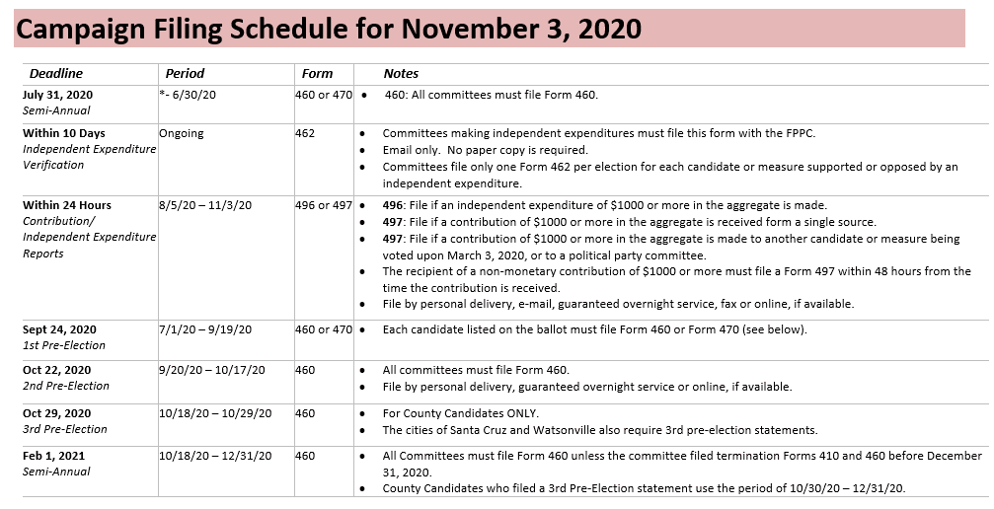

Slide 40

Don’t be late!
There are no provisions for granting “extensions” of the filing deadlines.
If a candidate, officeholder, or committee is required to file a statement and has failed to do so by the deadline, we will:
  Call you
  Provide written notice that statement must be filed within 10 days (5 days for 2nd Pre-Election Statement) noting that a fine of $10 per day beginning the day after the filing deadline until the date the statement is filed will be assessed unless waived by the Elections Official. The maximum penalty is $100 or the total amount of contributions received or the total amount of expenditures made (whichever is greater) during the period covered by the late statement.
Fines may not be waived if statement is not filed within 10 days after specific notice is sent by the elections official (or 5 days for 2nd Pre-Election Statements).
Failure to file a statement after appropriate notice will be referred to an enforcement official and can result in substantial criminal, civil and administrative penalties.

Slide 41
Need Help?
Contact the FPPC!
Email: advice@fppc.ca.gov
or
Phone: 866-ASK-FPPC (1-866-275-3772)
Telephone advice is available
Monday through Thursday: 9am - 11:30am
Other Resources:
Candidate Toolkit: http://fppc.ca.gov/learn/campaign-rules/candidate-toolkit-getting-started.html
Online video and slides: http://www.fppc.ca.gov/learn/campaign-rules/candidate-and-treasurer-online-video.html
Local workshop: Tuesday, August 11, 2020, 7:00 pm - 9:00 pm
E-Hosted Webinar by the City of Santa Clara. Register online at http://www.fppc.ca.gov/learn/training-and-outreach/candidates-treasurers-committees.html

Slide 42
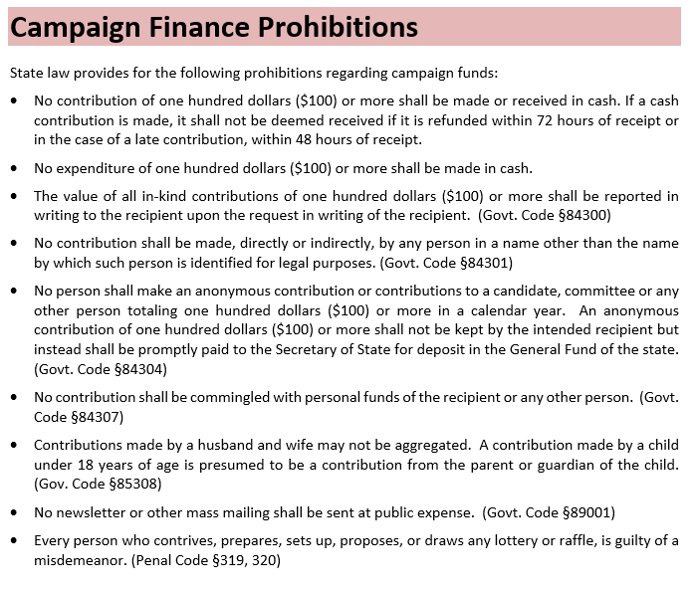
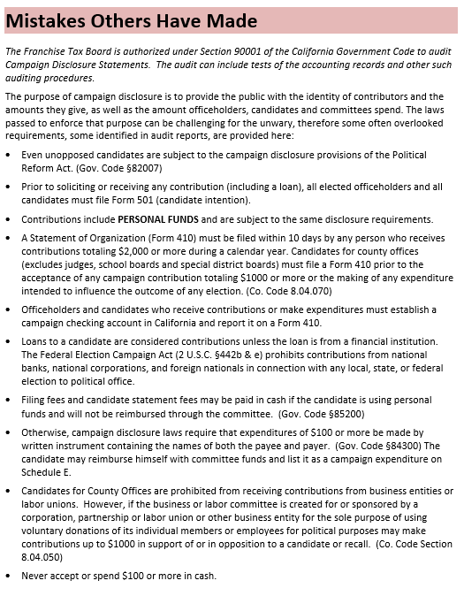
Two of my favorite pages in the Candidate’s Handbook

Slide 43
Form 700 Conflict of Interest Statement
File online with NetFile. To set up an account for school or special district candidates go online to www.votescount.us or contact Mari Segura at 831-454-2408 or mari.segura@santacruzcounty.us
For city candidates, contact Watsonville City Clerk Beatriz Flores or Assistant City Clerk Irwin Ortiz at 831-768-3040 or email cityclerk@cityofwatsonville.org
As a candidate, you are required to file a Form 700. It is a public document where you will disclose your financial interests.
The Form 700 provides transparency and ensures accountability in governmental decisions.

Slide 44
Write-in Candidates
File Sep. 7 to Oct. 20
Persons who did not file a Declaration of Candidacy and fulfill their nomination requirements to place their name on the ballot may run for office as a write‑in candidate.
Voters may write‑in any person they wish for any office regardless of whether the person has qualified or not. However, the votes will only be tabulated for qualified write-in candidates.
To qualify as a write‑in candidate a person must the following documents:
School & Special District candidates file with the County Clerk.
City Council candidates file with the City Clerk.
A “Statement of Write‑in Candidacy” which shall contain the candidate's name, residence address, a declaration stating that he or she is a write‑in candidate, the title of the office for which he or she is running and the date of the election.
A Nomination Petition with the required number of signers for the office sought.
In November, the offices requiring nomination signatures are: County Supervisor, Superior Court Judge and City Council.
Signers of nomination papers for write‑in candidates shall be voters in the district or political subdivision in which the candidate is to be voted on. §8603

Slide 45
Offices omitted from the ballot
Prospective write‑in candidates should note that write‑in candidacy is possible only if the office appears on the ballot. (2 CCR § 20102)
In November, write-ins are not allowed for the following offices: US Congress, State Senate, State Assembly. Elections Code §8600 (c)
If there is an insufficient number of nominees for a school or special district, the contest will not appear on the ballot.
Unopposed superior court judges will not appear on the November ballot. However, there is a provision in the law to require that the office be placed on the ballot by means of a petition procedure. Elections Code §8203

Slide 46
Ballot processing and counting…
Since all voters will be mailed a ballot, we will process ballots and prepare for ballots to be counted as soon as they are received pursuant to a new law enacted on 6/18/2020.
Of course, we can only process votes if we have them. We encourage voters to vote early, and not wait until the last day.
Step 1 – peel signature tab from envelope (we did 70,678 ballots in March 2020!)
Step 2 – run ballots through sorter where the signature is captured.
Step 3 – clerks at computers will pull up batches where they can view 5 signatures from ballot envelopes and the signature from the corresponding voter for each voter.
Step 4 – ballots are sorted into good sigs match, no sig (letter sent) and sig compare questions, which get checked by another clerk.
  Step 4a – letters are sent to the voters who did not sign their envelopes so they can fill out a form and cure their missing signature.
  Step 4b – envelopes where sigs don’t compare are put through two clerks for double checking. We will try to search for other signatures, printing, etc. We will try to call or email the voter if they have provided that information. Otherwise, they are sent a letter with a form they can fill out to cure their non-comparing signature.

Slide 47
Ballot processing and counting continued
Step 5- envelopes are opened and ballots are extracted.
  Step 5a – clerks work in teams and make sure if they have 100 empty envelopes, they have 100 ballots.
  Step 5b – if there are any ballots that cannot be read by the scanners due to tears or spills, the ballots are sent to a ballot duplicating board.
Step 6 – ballots are bundled and labeled with a form to be sent to ballot counting.
Step 7 – ballots are counted in batches and the form is completed with the operator number, initials, number counted and number rejected.
  Step 7a – ballots that have been successfully counted are put into boxes, marked and stored.
  Step 7b – ballots that were not counted, go to a ballot duplicating board.
Step 8 – ballots that need adjudication, are reconciled at computer stations.
Step 9 – ballots are tallied, and the vote is audited.
Step 10 – the ballot count is posted on the website as an update.

Slide 48
Election Night
Polls close at 8pm
Ballot drop boxes close at 8pm
We will continue to process and tally ballots until 11pm.
At 11pm, we will focus on scanning and final counting of the ballots we have in the system.
Semi-official election night results will be released sometime after midnight.
History has shown that we will count more ballots after Election Day than on Election Night.
So no victory parties yet! Results are NOT final until all votes are counted, audited, and verified.
Election officials are big fans of big margins!!

Slide 49


The Canvass
Like fine wine, it takes time.
The Canvass is the official tally of votes for any given election. The purpose of the canvass is to account for every ballot cast and ensure that every valid vote cast is counted accurately in the final election totals.
The Canvass accounts for every ballot cast on Election Day, every qualified returned ballot from voters who voted using the ballot we mail them, every qualified Same Day Voter Registration ballot, every accepted provisional ballot, every challenged ballot, and every qualified military and overseas ballot.
The Canvass enables an election official to resolve discrepancies, correct errors, and take any remedial actions necessary to ensure completeness and accuracy before certifying the election.
Estimated number of outstanding ballots will be prepared by Friday, including the number of Same Day and Provisional Ballots. We will not have the number by district until the ballots are all keyed in as returned.
There are several audits conducted during the Canvass to verify the results including a 1% manual tally of the results making sure every contest is audited.

Slide 50
Final Election Results
Deadline to certify is Dec. 1 for presidential contest, Dec. 3 for all others.
By November 30, the county elections official shall declare the elected candidate or candidates to all school and special district holding elections in November. This statutory deadline conflicts with the first one.
Within five (5) days after the completion of the official canvass, any voter may request a recount by filing a written request with the Elections official and specifying that candidates and/or measures are to be recounted.

Slide 51

Assuming office
December 4 – Special Districts: Candidates declared elected or appointed take office this date at noon after having taken the oath or posted any bond required by the principal act. §10554
December 4 – School and Community College Districts: Candidates elected to school board take office, though no reference is made to “noon.”
December 7 – State Senate and State Assembly Members take office.
December 8 – Watsonville City officials take office.
January 3 – Congressional members take office.
January 4 – County Supervisors and Superior Court Judges take office.
January 20 – Inauguration Day. President takes office at noon.

Slide 52
Outstanding issues
Hotline for voter questions and election worker questions
App to track wait times at voting locations
Laws changing: SB 423 (Umberg) and AB 860 (Berman): deadline to register, E+3, time to certify, etc.
What will be happening with the virus in October/November. Need flexibility.
Staffing and training of election workers
Establish mechanism for public feedback and suggestions
One place to get latest election news – VOTESCOUNT.US
Funding – How do we pay for this?

Slide 53
Questions?
Feedback?
Gail Pellerin – Santa Cruz County Clerk, 831-454-2419
gail.pellerin@santacruzcounty.us
Mari Segura – Candidate Filing Coordinator, 831-454-2408
mari.segura@santacruzcounty.us
Beatriz Flores – Watsonville City Clerk, 831-768-3040
beatriz.flores@cityofwatsonville.org
Irwin Ortiz – Watsonville Assistant City Clerk, 831-768-3048
irwin.ortiz@cityofwatsonville.org
New URL for website!! www.votescount.us
.com will redirect to new url

